Slide 1
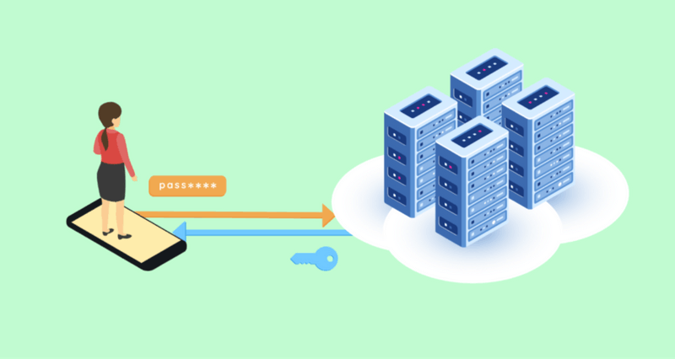
Session Management and Security
By: Rishi & Ian

Slide 2
Session and Session IDs
Sessions:
Store user data across multiple pages in web applications.
Maintain user state, preferences, and authentication details.
Saves on the server side and identified by a unique Session ID.
Session ID:
Unique identifier assigned to each user's session.
Stored in cookies and sent with each request to the server
Essential for tracking user activity and preferences.
Notes:
Session is just like piece of data that a server keeps track of a user as they're using the website. It is helpful to keep track of what the user has done before and what they've done on your website so far. Example – Login authentication

Slide 3
How does a PHP session work?
Sessions are an extension of functions in PHP.
First-time users visits a web page it calls php_session_create_id() automatically.
PHP checks for existing session IDs using GET and POST data.
Retrieves the Session ID from the cookie.
Opens a file storing the session on the client's device.
Saves data in the "$_SESSION" variable for reference
Notes:
When user visits a website that initiate session_start() that checks for session ID using cookies or URL parameters. PHP checks GET and POST data to see if session ID exists. If no session Id exists a new session ID is created. The new session file is created on the server to store user data. If session Id exist it stores the data via $_SESSION (global variable).

Slide 4
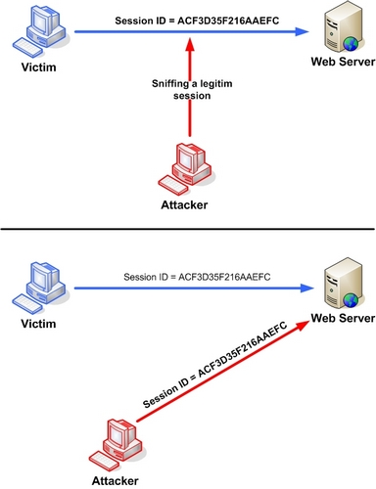
Session Hijacking
Attacker that takes over an existing session using the Session ID.
Network interception in unsecured environment (e.g., public Wi-Fi).
Techniques:
Man-in-the-Middle (MITM) to capture user-server connections.
Cross-Site Scripting (XSS) to steal Session IDs.
Address Resolution Protocol (ARP) Poisoning
Notes:
MITM: Attacker intercepts communication between the user and the server, allowing them to capture sensitive information.
XSS: Attacker injects malicious scripts into web pages that execute in users' browsers, potentially capturing Session IDs.
ARP: Attacker sends malicious ARP replies to associate their MAC address with the target IP address, enabling them to intercept traffic.

Slide 5
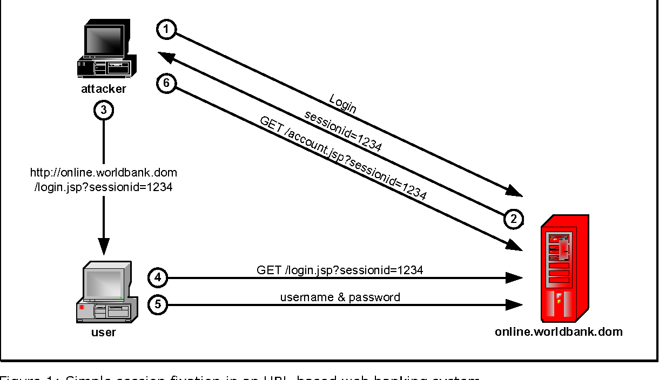
Session Fixation
Attack where a hacker tricks a user into using a Session ID they control.
Process:
The attacker obtains a valid Session ID from a web application.
They send fake links with a fake login page to the user.
Once the user authenticates with the malicious Session ID, the attacker gains access to the user's account.

Slide 6
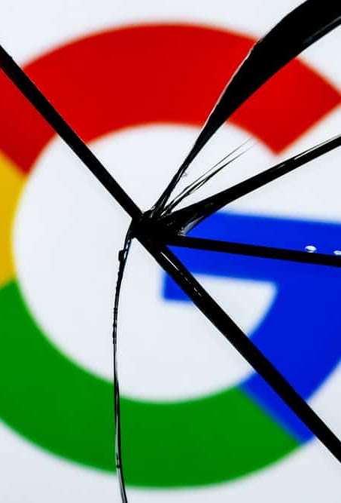
Highlighting importance: Google Account Session exploit
In late 2023, a bug in Google's cookie authentication was found
Hackers used this to steal user accounts and collect their data
They took advantage of the exploit by using malware
Google hides information about the API that caused the exploit

Slide 7

Preventing session attacks
It is the job of the developer to prevent attacks through sessions
There are many measures that can be taken in PHP to help prevent session exploitation
Session Regeneration
Session Expiration Checks
HTTPS Enforcement

Slide 8
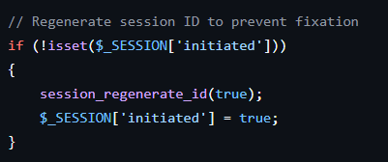
SESSION regeneration
Generates a new session ID after logging the user in
Old session IDs are voided and will not grant access
A powerful tool against session fixation
In PHP, uses the "session_regenerate_ID()" method

Slide 9
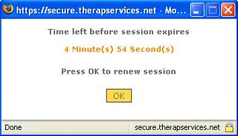
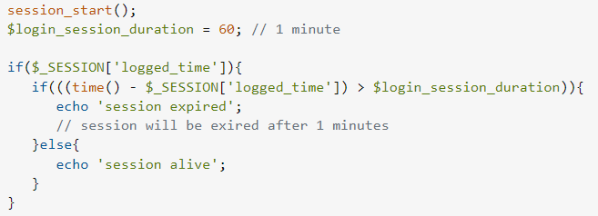
SESSION EXPIRATION CHECKS
The length of a session's life should be explicitly defined
Session expiration will help lessen the time an attacker gets to validate a session with a given ID
Checks for repeated attempts to use expired sessions can be utilized to identify attackers attempting to steal data

Slide 10


Https enforcement
Authentication cookies should always be sent over HTTPS
Ensures a more secure transmission between the client and server, encrypting sensitive information
This should be enforced in session PHP source code
Great protection against MITM attacks
Helps prevent Session Hijacking

Slide 11

Thank you for listening! We hope you now understand session management and security a little more!

